Slide 1


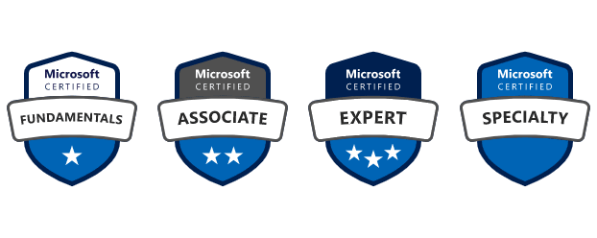


Azure & DevOps Study Group
Free Live Webinar
AZ-900: Microsoft Azure Fundamentals
Module 2: Building Azure Solutions Using Azure Services
08/11/2021
07:00 PM UK

Slide 2
Module 2:
Building Azure Solutions Using Azure Services

Slide 3
Module 2: Intro
Introduction and Module Overview

Slide 4
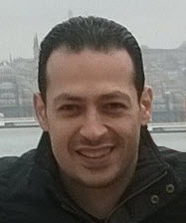





About The Presenter
Mohamed Radwan
Principal DevOps Consultant/ NTT DATA UK. Over 19 years of experience
Microsoft Azure DevOps & GitHub MVP for 10 years
Helped more than 50 enterprise companies some of them from the Fortune 500
Presented hundreds of sessions in many conferences & events around the globe
Developed many tools and frameworks on GitHub and Azure DevOps Marketplace
mohamedradwan.com
Notes:
How Cloud Can Help DevOps Transformation

Slide 5


Module 2: Overview
This lesson will cover
Speakers and Lessons of This Module
Lessons and Allocated Time of This Module
Overview About Each Lessons in This Module
Notes:
How Cloud Can Help DevOps Transformation

Slide 6
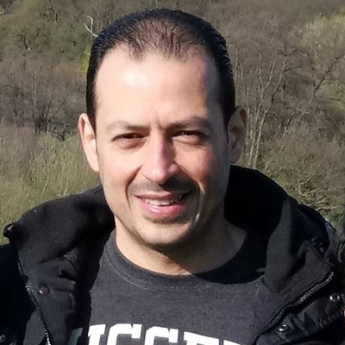
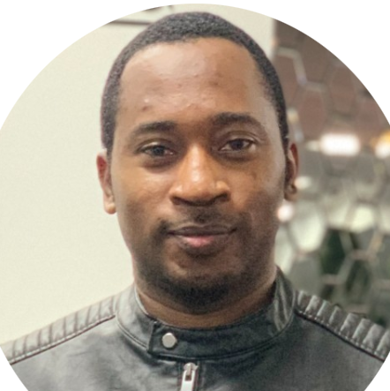
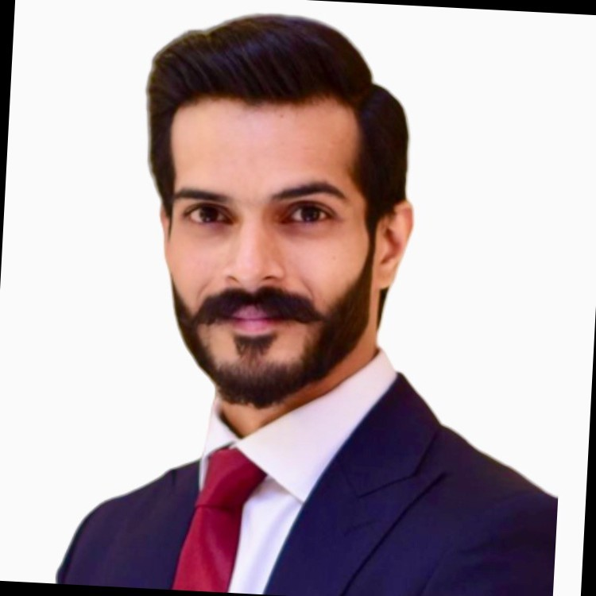
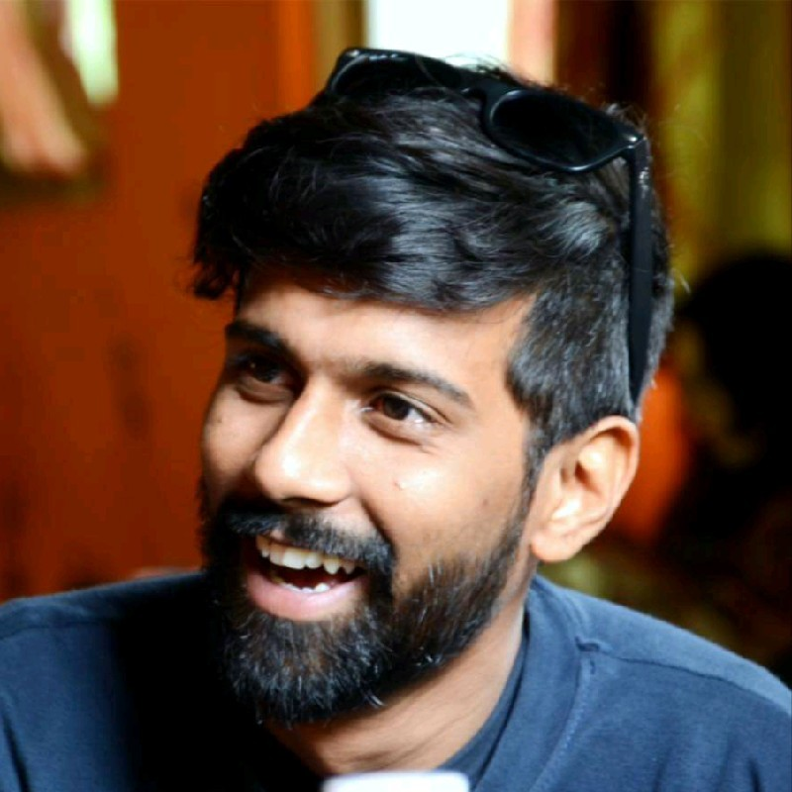



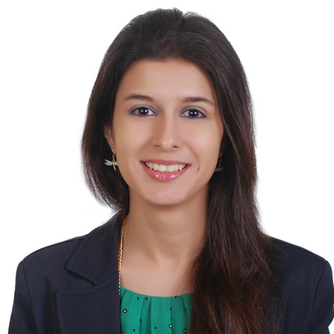
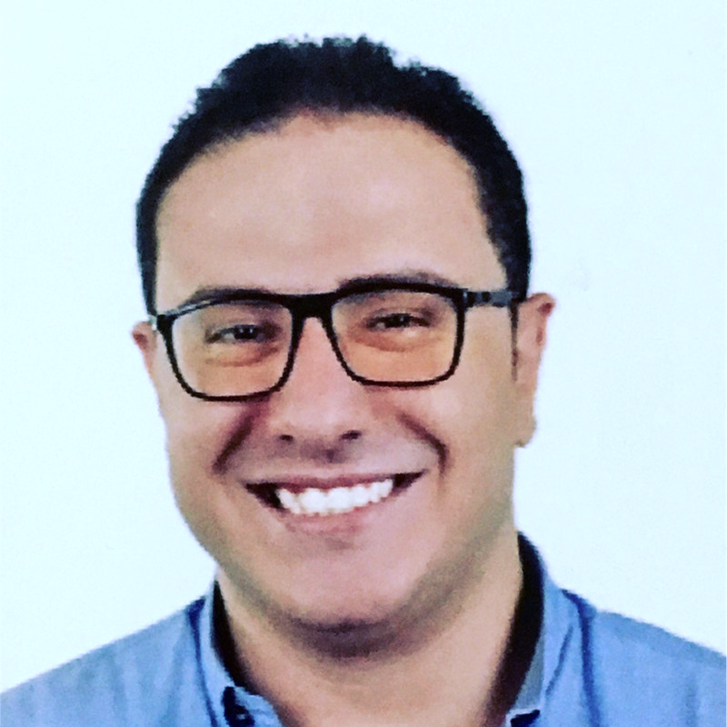

Module 2: Speakers and Lessons
Mohamed Radwan
Principal DevOps
NTT DATA UK
UK/London
Olutayo Adaraloye
Cloud Infra Engineer
Horwich Farrelly
UK/Manchester
Sarmad Raza
Sr.Apps & infra Consultant
Info & Comm Technology W.L.L
Qatar/Doha
Mayank Khudia SRE/DevOps Lead
OliveTech Cloud
India/Gurugram
(0) Introduction and Module Overview
(1) Choose the best Azure IoT service for your application
(2) Choose the best AI service for your needs
(3) Choose the best Azure serverless technology
Aaron Hughes Senior Consultant
Hitachi Solutions
UK/Plymouth
Marwa Eshra Data Scientist
Dell Technologies
Egypt/Alexandria
Mohamed Zaky Elkassed Sr. Solutions Developer
Link Development
Egypt/Alexandria
(4) Choose the best tools to help organizations build better solutions
(5) Choose the best tools for managing and configuring your Azure environment
(6) Choose the best monitoring service for visibility, insight, and outage mitigation

Slide 7
Module 2: Agenda and Allocated Time
Lesson No | Speaker Name | Lesson Title | Allocated Time (UK)
0 | Mohamed Radwan | Introduction and Module Overview | 07:00 – 07:05 PM
1 | Olutayo Adaraloye | Choose the best Azure IoT service | 07:05 – 07:30 PM
2 | Sarmad Raza | Choose the best AI service | 07:30 – 07:55 PM
3 | Mayank Khudia | Choose the best Azure serverless | 07:55 – 08:20 PM
Break |  |  | 08:20 – 8:30 PM
4 | Aaron Hughes | Choose the best tools to build better solutions | 08:30 – 08:55 PM
5 | Marwa Eshra | Choose the best tools for managing/configuring Azure environment | 08:55 – 09:20 PM
6 | Mohamed Zaky Elkassed | Choose the best monitoring service for visibility, insight, and outage mitigation | 09:20 – 09:45 PM
Notes:
How Cloud Can Help DevOps Transformation

Slide 8
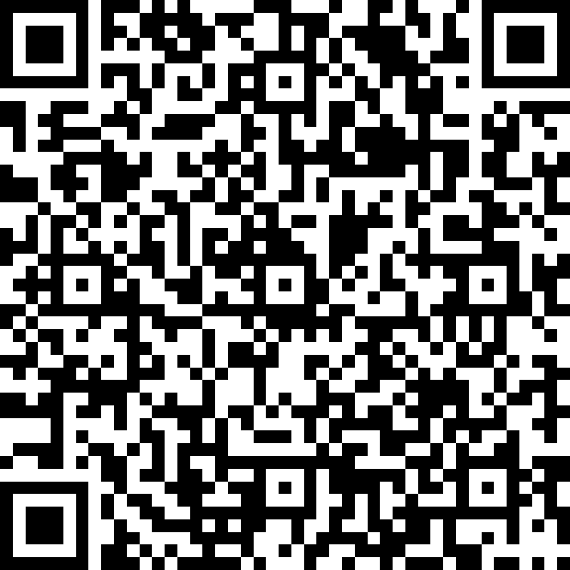
Module 2: Feedback Survey
https://bit.ly/3q30ARn
Notes:
How Cloud Can Help DevOps Transformation

Slide 9

Summary
This lesson has covered
Speakers and Lessons of This Module
Lessons and Allocated Time of This Module
Overview About Each Lessons in This Module
Next Lesson:
( 1 ) Choose the best Azure IoT service for your application
Notes:
How Cloud Can Help DevOps Transformation

